Slide 1

Ultrasonic vibrations in metallurgy… with MMM Technology
www.UltrasonicMetallurgy.com
Degassing of Al and Mg alloys
Grain refinement of Al and Mg alloys
by M. Prokic
Patent
MP Interconsulting
Marais 36,
2400 Le Locle, Switzerland
www.UltrasonicsWorldGroup.com
Phone: +41-32-9314045
Fax: +41-32-9314079
www.mpi-ultrasonics.com
mpi@mpi-ultrasonics.com
European Patent Application (related to MMM technology): EP 1 238 715 A1
Multifrequency ultrasonic structural actuator
Applicant: Prokic Miodrag, MP Interconsulting, 5.03.2001 – 11.09.2002

Slide 2
… proposal for your factory:
Cavitation in Metallurgy
Principle:
Supplying acoustic energy to a melt, in order to induce cavitation and initiate Sonocrystallization:
(i) A great number of small cavities developed inside the liquid.
(ii) Diffusion of hydrogen from the melt to developed bubbles
(iii) Large bubbles coagulate and float to a surface of liquid pool
Degassing
Besides degassing, the development of cavitation promotes significant undercooling and formation of numerous solidification nuclei.
Refinement of
α-Al
Grain refinement exerts a positive influence on several properties of cast aluminum, namely: porosity, shrinkage distribution, intermetallic distribution and mechanical properties.
Ultrasound above the threshold of acoustic cavitation can be introduced into a molten metal promoting:
Degassing of liquid metals using high intensity ultrasonic activity.
Grain refinement, Si eutectic and intermetallic modification.
2021 ® MP Interconsulting || Marais 36, 2400 Le Locle, Switzerland ||www.UltrasonicsWorldGroup.com || mpi@mpi-ultrasonics.com

Slide 3
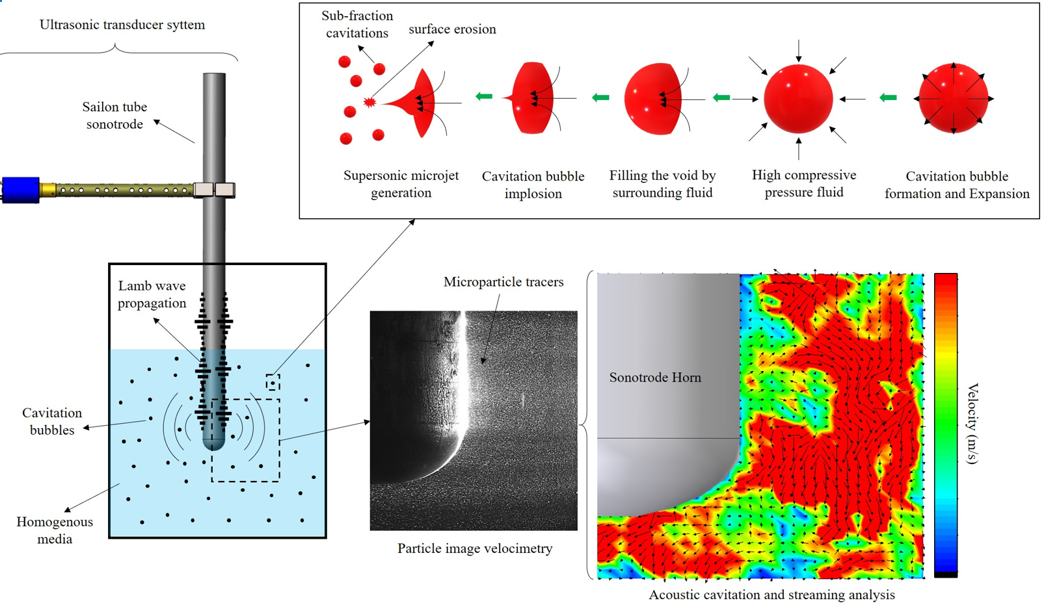
… proposal for your factory:
Cavitation in Metallurgy
Degassing
2021 ® MP Interconsulting || Marais 36, 2400 Le Locle, Switzerland ||www.UltrasonicsWorldGroup.com || mpi@mpi-ultrasonics.com

Slide 4
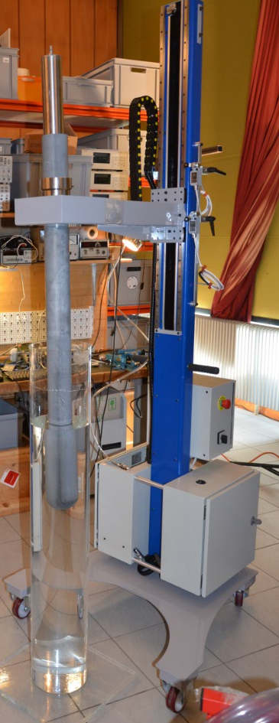
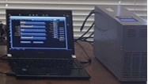
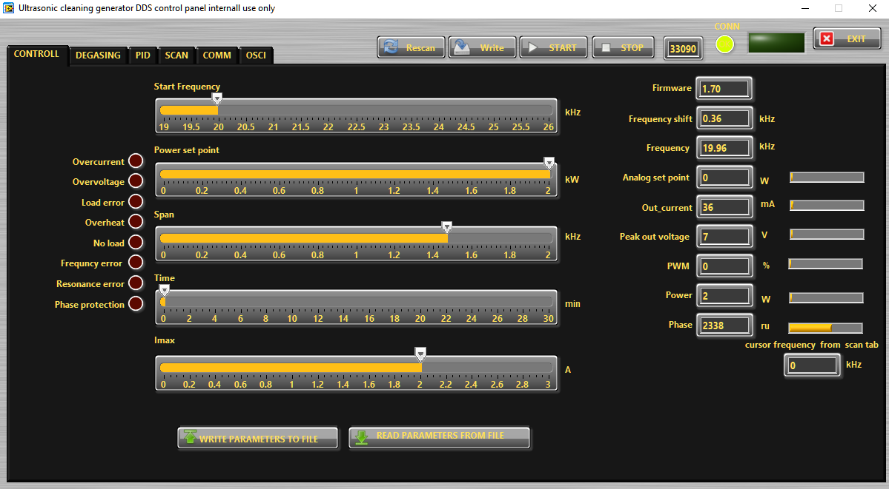
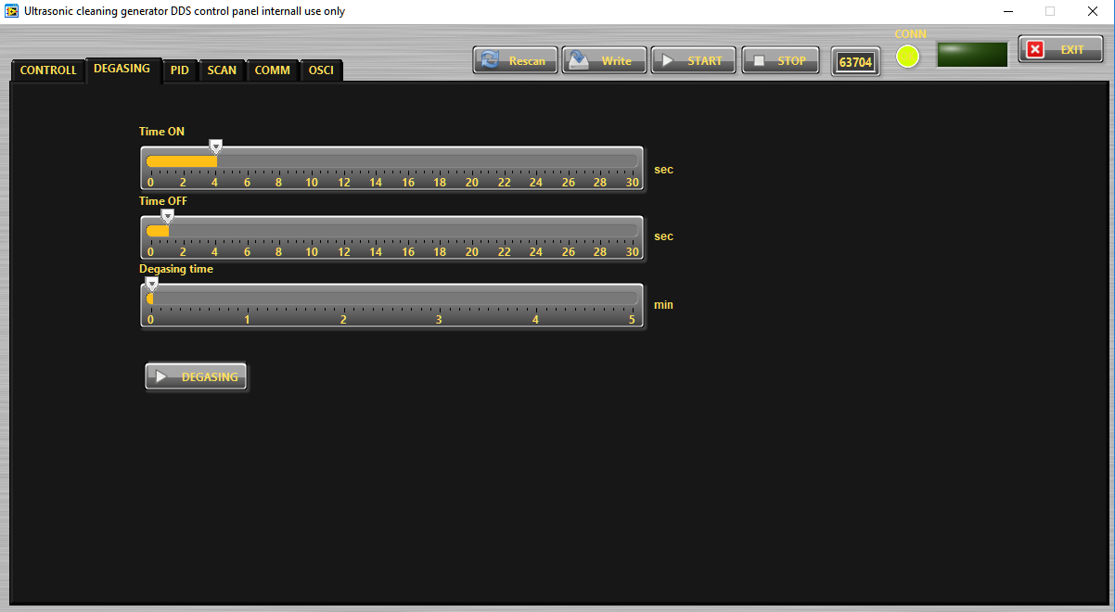
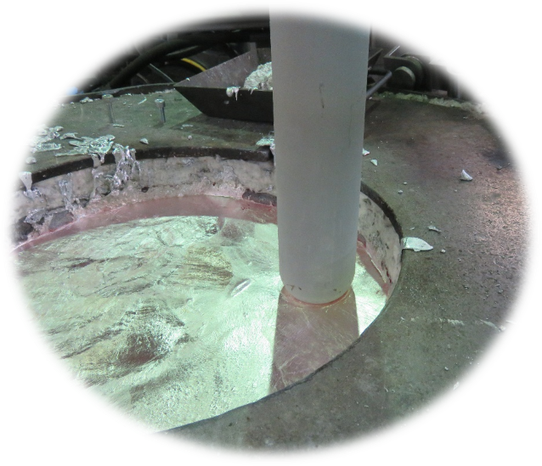
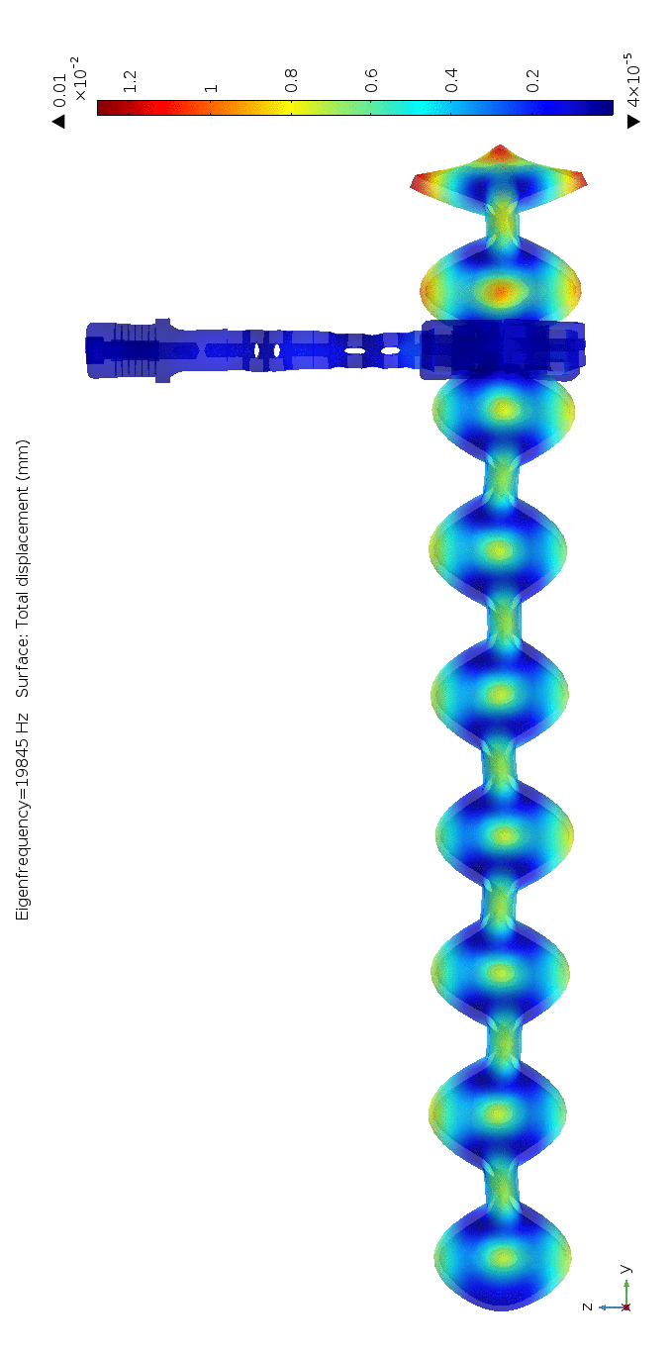
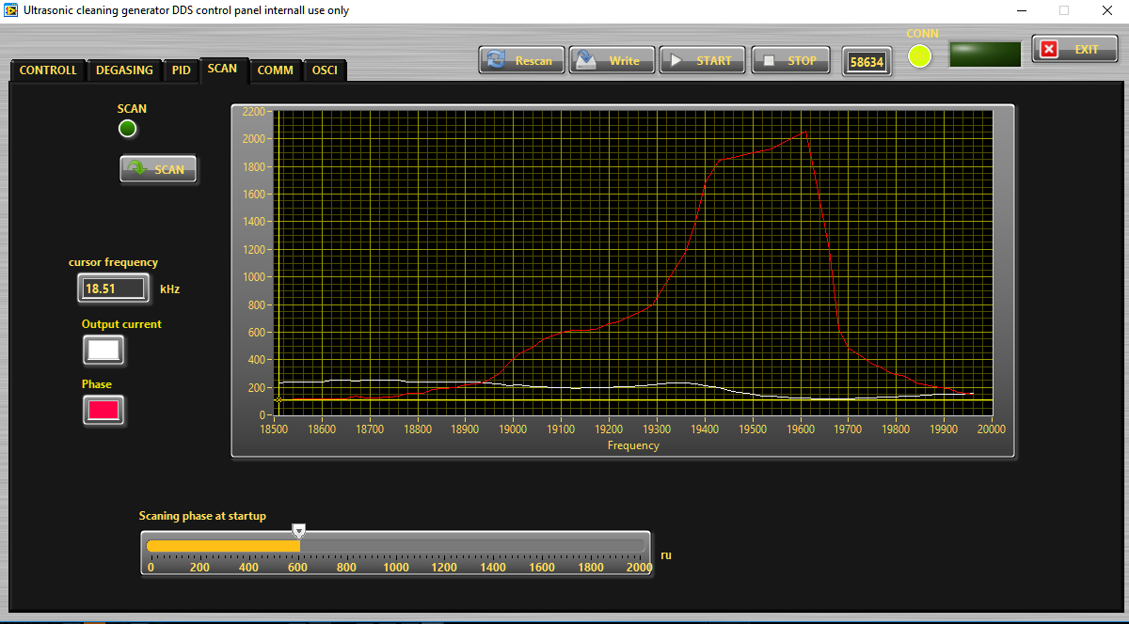
MPI Dedicated Software Control
2021 ® MP Interconsulting || Marais 36, 2400 Le Locle, Switzerland ||www.UltrasonicsWorldGroup.com || mpi@mpi-ultrasonics.com

Slide 5
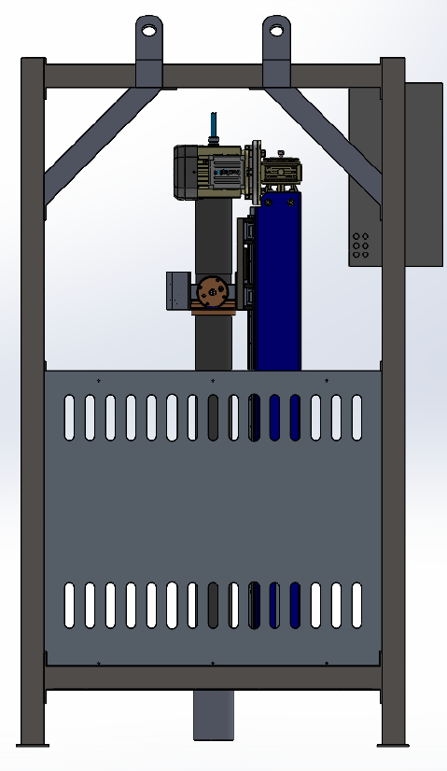
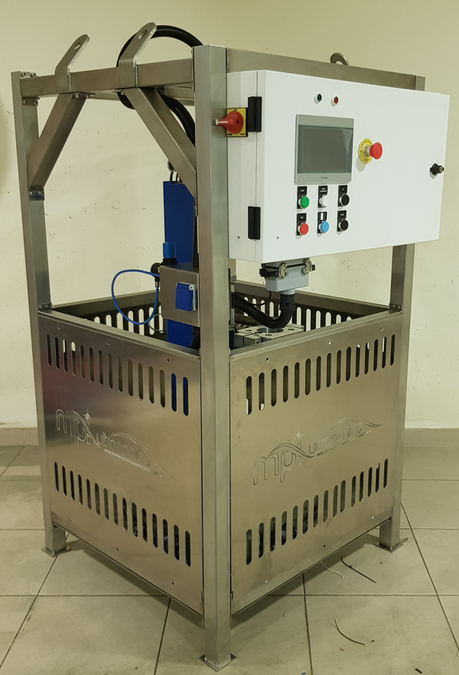
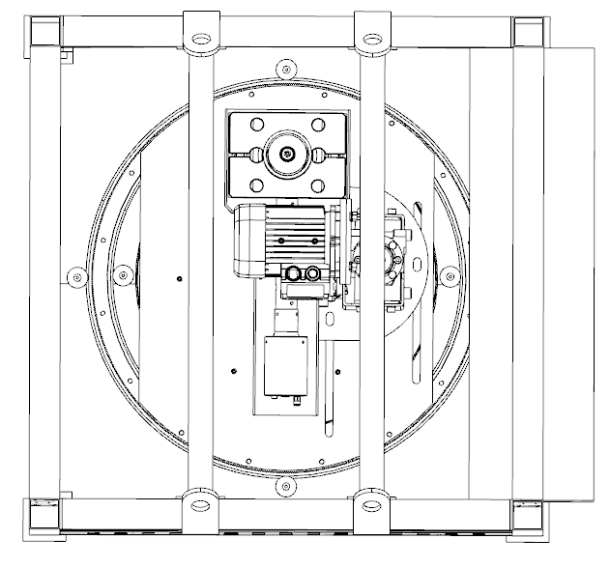
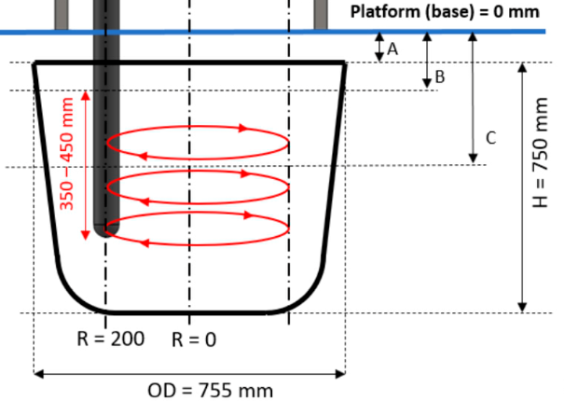
… New Device for You
Dynamic Stirring rotation
available for degassing of aluminum alloys in a furnace / crucible
2021 ® MP Interconsulting || Marais 36, 2400 Le Locle, Switzerland ||www.UltrasonicsWorldGroup.com || mpi@mpi-ultrasonics.com

Slide 6
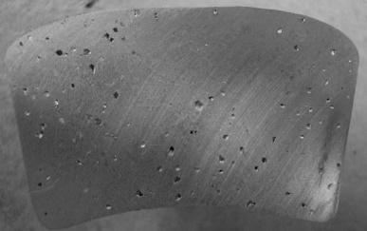
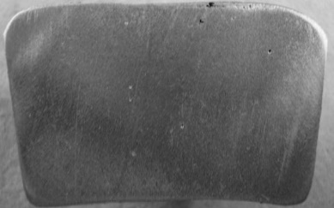
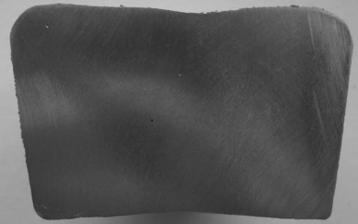
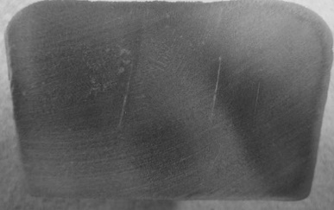
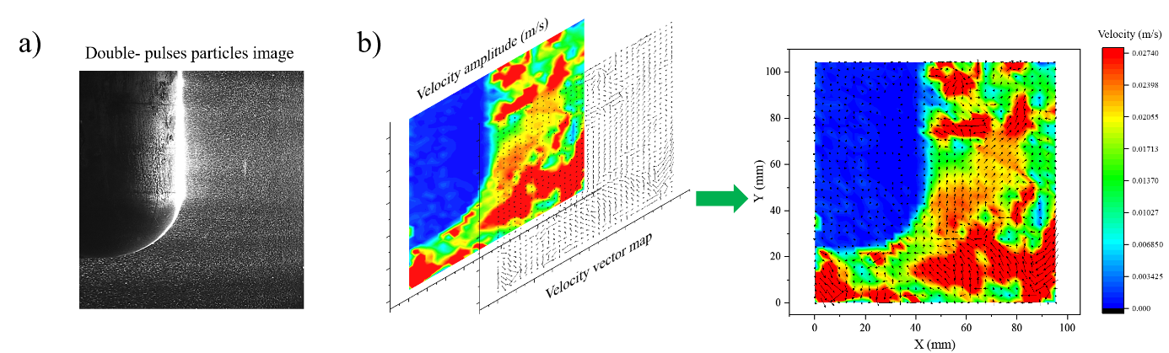
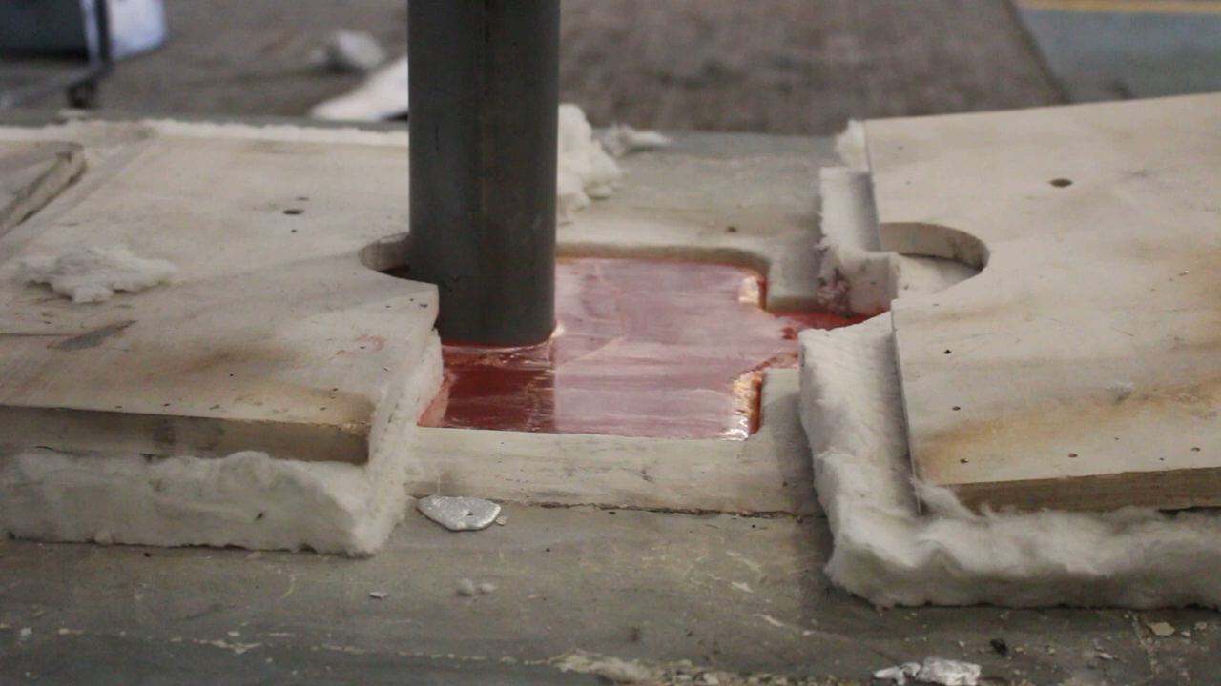
Porosity
Al-Si-Cu
Degassing
α-Al
Si
0 min
1 min
3 min
5 min
Refining
Modification
Intermetallics
Spatial distribution of acoustic flow from the transducer radial sonication of SiAlON tube.
2021 ® MP Interconsulting || Marais 36, 2400 Le Locle, Switzerland ||www.UltrasonicsWorldGroup.com || mpi@mpi-ultrasonics.com

Slide 7
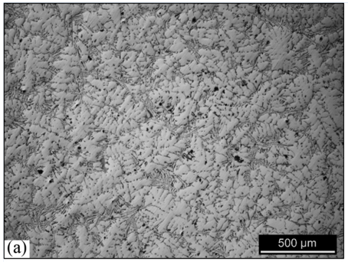
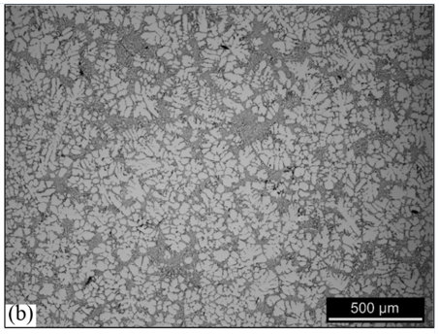
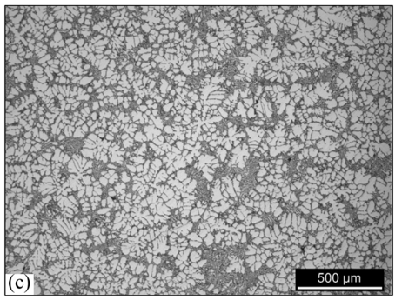
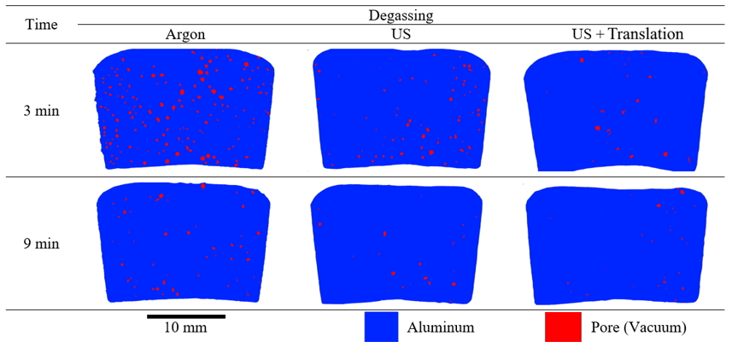
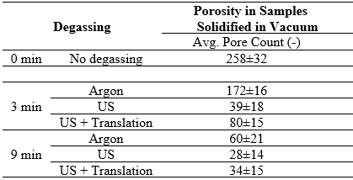
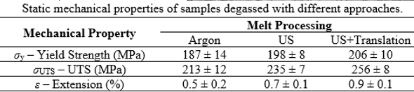
The samples with ultrasonically treated melt display a moderate grain refinement. The micrographs can evidence this behavior, as the Argon degassed micrograph in Figure (a) displays large dendrites, while Figures (b) and (c) show globular and rosette-like α-Al grains, highlighting some moderate grain refinement promoted by the ultrasonic melt treatment.
Porosity
Degassing
α-Al
Si
Refining
Modification
(a)
(b)
(c)
Intermetallics
2021 ® MP Interconsulting || Marais 36, 2400 Le Locle, Switzerland ||www.UltrasonicsWorldGroup.com || mpi@mpi-ultrasonics.com

Slide 8
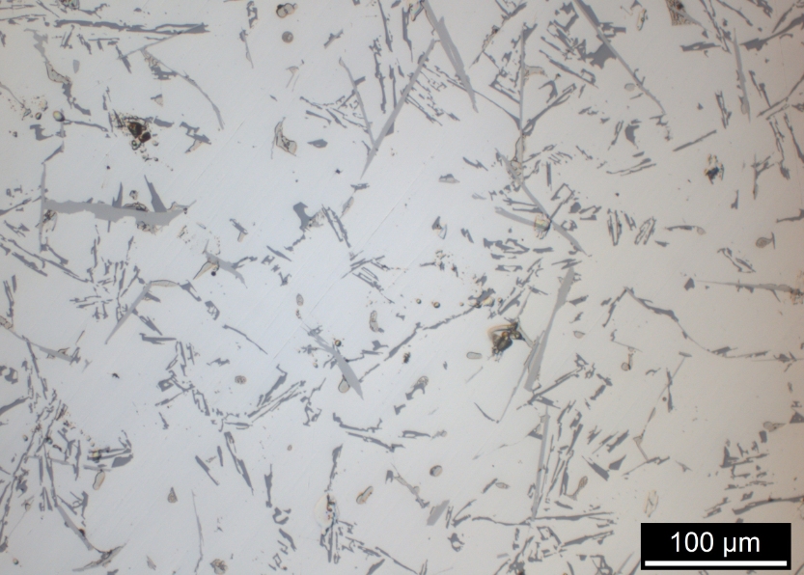
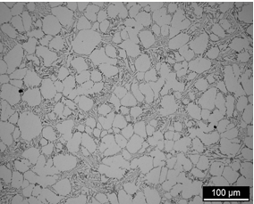
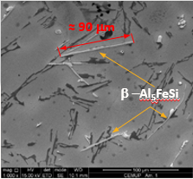
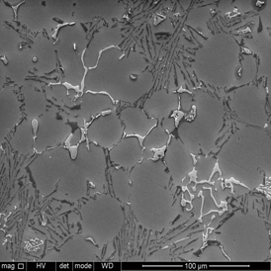
Optical microscope (OM) and Scanning Electron Microscope (SEM) with quantitative metallographic analysis capability were used to evaluate the shape and grain size of constituents ….
Porosity
Al-Si-Cu before ultrasonic processing
Al-Si-Cu after ultrasonic processing
Degassing
α-Al
Si
Refining
Modification
Intermetallics
2021 ® MP Interconsulting || Marais 36, 2400 Le Locle, Switzerland ||www.UltrasonicsWorldGroup.com || mpi@mpi-ultrasonics.com

Slide 9

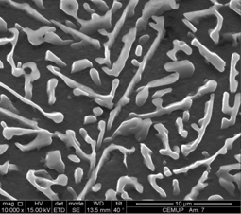
Optical microscope (OM) and Scanning Electron Microscope (SEM) with quantitative metallographic analysis capability were used to evaluate the shape and grain size of constituents ….
Porosity
Degassing
α-Al
Si
Refining
Modification
Intermetallics
2021 ® MP Interconsulting || Marais 36, 2400 Le Locle, Switzerland ||www.UltrasonicsWorldGroup.com || mpi@mpi-ultrasonics.com

Slide 10
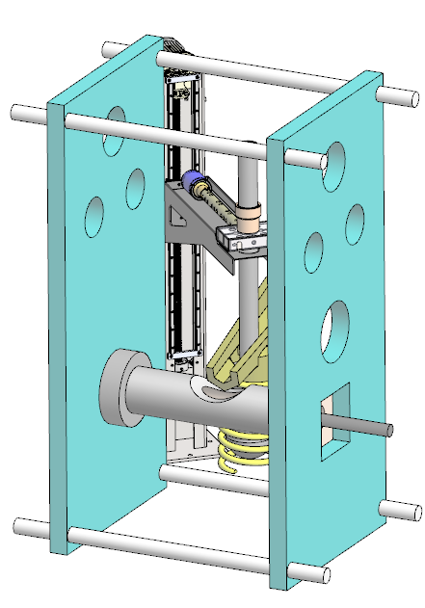
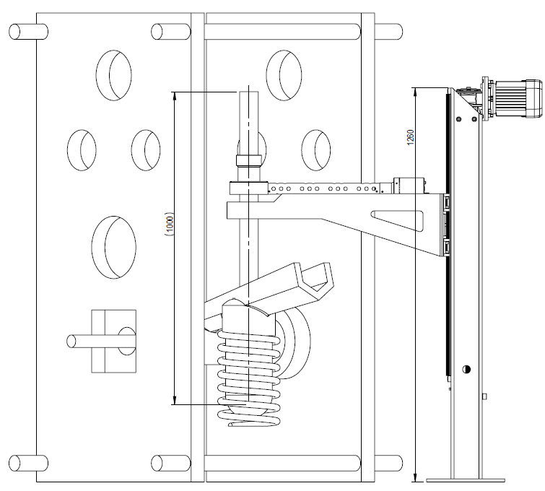
… proposal for HPDC …
Cavitation in Metallurgy
Degassing
available for degassing and refinement localized of aluminum alloys in a HPDC process
… new concept …
… adjustable …
2021 ® MP Interconsulting || Marais 36, 2400 Le Locle, Switzerland ||www.UltrasonicsWorldGroup.com || mpi@mpi-ultrasonics.com

Slide 11
… proposal for HPDC …
Cavitation in Metallurgy
Degassing
available for degassing and refinement localized of aluminum alloys in a HPDC process
… new concept …
… adjustable …
2021 ® MP Interconsulting || Marais 36, 2400 Le Locle, Switzerland ||www.UltrasonicsWorldGroup.com || mpi@mpi-ultrasonics.com

Slide 12
Thank You.
www.UltrasonicMetallurgy.com
… the future of your company start here with MMM Technology.
MP Interconsulting
Marais 36,
2400 Le Locle, Switzerland
www.UltrasonicsWorldGroup.com
Phone: +41-32-9314045
Fax: +41-32-9314079
www.mpi-ultrasonics.com
mpi@mpi-ultrasonics.com

